Slide 1


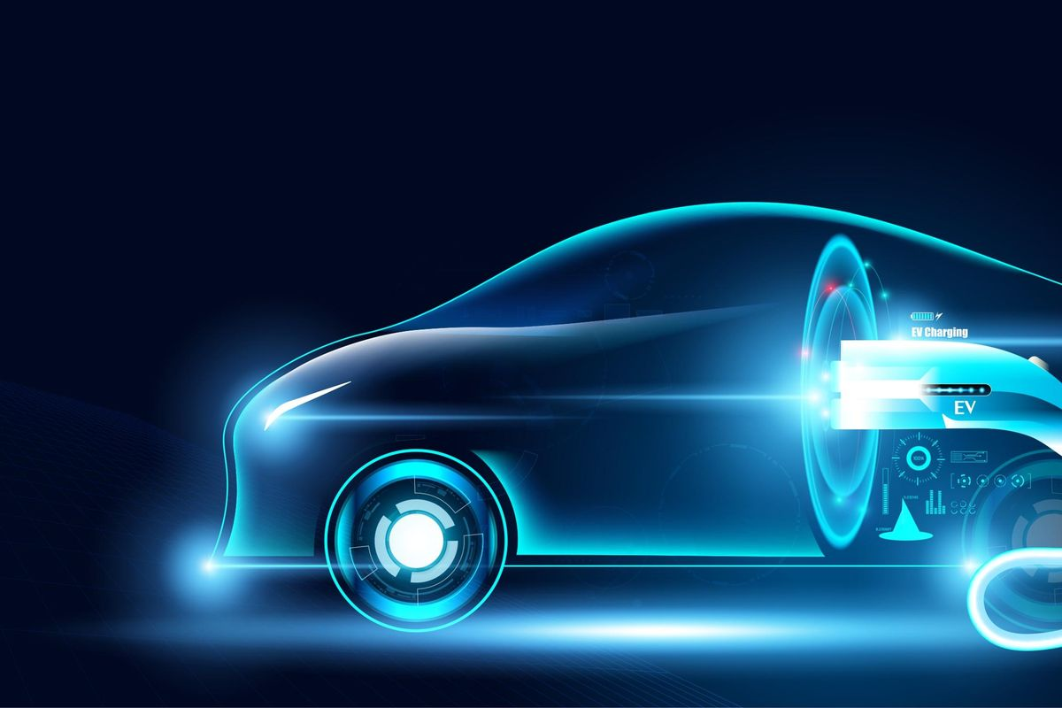


Global EV Market:
The Real Story
Strategic Insights from 2015–2025 Sales Data
Presented by – Asif khan

Slide 2











The Data Foundation
Comprehensive Dataset
Global Scope
Analysis grounded in a robust dataset of 3,022 unique EV models, providing extensive coverage of the global EV market.
Analysis encompasses all major EV manufacturers and regions worldwide, providing a holistic view of the market.
Time Span
Primary Goal
Data collected from 2015 through 2025, providing a decade-long perspective on market evolution and trends.
Identify the true "money-makers" and pinpoint critical "tech gaps" within the EV market.
"Our analysis moves beyond anecdotal evidence and marketing claims, focusing instead on the underlying engineering and financial realities that drive the industry."
2/9

Slide 3




















How We Crunched the Numbers
Custom metrics to evaluate technological quality and financial impact beyond raw data
+
+
+
Raw Data
Price
Range
Battery
Units
Derived Metrics
Efficiency Score
Revenue Weight
Market Segmentation
Range (km) / Battery (kWh)
Price × Units Sold
Logical categorization (e.g., Price > $80k = "Luxury")
Evaluates technological quality and engineering prowess, rather than focusing on battery size.
Identifies "cash cows" within the market, distinguishing between high sales volume and high revenue generation.
Allows for clearer understanding of market structure and identification of underserved areas or market voids.
3/9

Slide 4








The Market's Pulse
Key statistics revealing the current state of the EV market
Average Price
Average Range
$90,611
350
km
Market skewed towards premium segments. Affordable EVs remain unaddressed.
350 km range emerges as critical benchmark. Vehicles below this risk invisibility to buyers.
Average Sales
Charging Time Gap
10,200
30
12
Units
min
to
hours
Sales performance inconsistent, with std dev of ~5,700 units. Brand loyalty matters.
Vast disparity in charging times points to fragmented ecosystem, creating driver frustration.
4/9

Slide 5















Dashboard Showcase
Core market statistics at a glance
Average Price
Average Range
$90,611
350
km
Average Sales
Charging Time Gap
10,200
30
min
12
hours
Units
5/9

Slide 6









Strategic Insights - Efficiency is King
Data reveals efficiency ratios matter more than battery size, challenging the bigger battery equals better car myth.
The Myth
The Reality
"Bigger battery equals better car"
High efficiency scores indicate better engineering
km/kWh
Conventional wisdom prioritized battery容量
Higher range with smaller batteries
Ignored engineering efficiency
Reduced weight and manufacturing costs
Led to heavier, more expensive vehicles
Better overall performance
Key Takeaway: Future R&D should focus on motor technology and energy management systems, not just battery capacity.
6/9

Slide 7




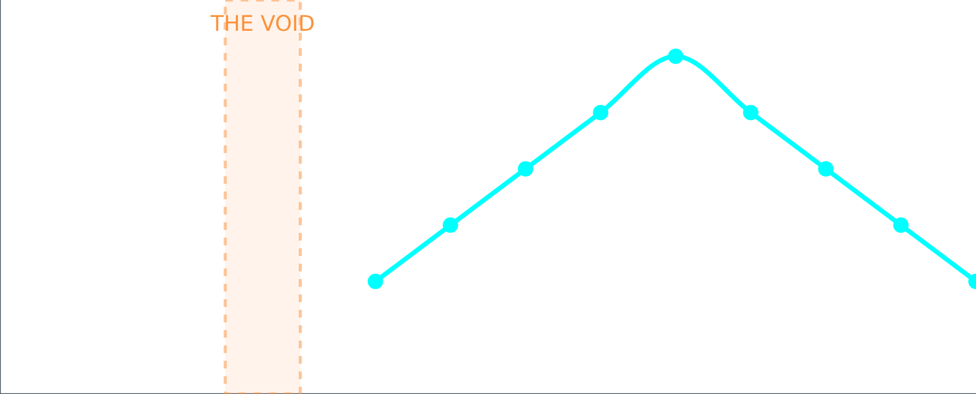






Strategic Insights - The Market Void
Market Price Distribution
The Risk
Entry-level price is way too high (~$30k+), creating a significant barrier for mass market adoption.
The Opportunity
Own the mass market with a 350km range EV at $35k, capturing a substantial share of potential buyers currently underserved.
$0
$30k
$40k
$80k+
THE MARKET VOID
The Market Signal
Current EV market heavily skewed towards premium segments, with a significant gap in the $30,000–$40,000 range.
"The first company to drop a car in this 'Void'—with that standard 350km range—is gonna clean up with the average buyer."
7/9

Slide 8











Where We're Going (2026+)
Market trajectory shows strong recovery and growth forecast
2023 Dip
EV Market Trajectory
Sales corrected to approximately 2.6 million units, triggering speculation about an "EV cooling" period.
2025 Recovery
Market quickly rebounded to an estimated 2.9 million units, demonstrating resilience and adaptability.
2026+ Prediction
Annual EV sales projected to surpass 3.0 million units by 2026, driven by more efficient and market-aligned models.
"The 2023 dip was a market adjustment rather than a fundamental collapse, reflecting the industry's underlying strength and adaptability."
8/9

Slide 9









Wrapping It Up
Key recommendations for future success
Immediate Action
Next Phase
Strategic Direction
Standardize charging infrastructure to address the 30-minute to 12-hour charging time gap. Users can't deal with a 12-hour swing in fueling time.
Integrate warranty claims data to identify common failure points and improve vehicle reliability. We know what sells, but we need to know what breaks.
Target the mass market "void" with an affordable EV offering 350km range at around $35k. The first company to own this segment will capture substantial market share.
"The next winner will be defined by Efficiency, not Excess."
Thank you for your attention
9/9

